Slide 1
CAR DHEKO –USED CAR PRICE PREDICTION
A Comprehensive Machine Learning Project in the Automotive Industry
-BY
MATHESH .M

Slide 2
OBJECTIVE
Goal.
Predict the prices of used cars based on various factors such as mileage, year of manufacture, engine specifications, etc.
Provide insights for better decision-making in the automotive resale market.
Industry.
Automotive
Key Deliverables
Price prediction model, insights, and deployment through a Streamlit app.

Slide 3
DATASET OVERVIEW
The project utilizes four key datasets:
NEW_CAR_DETAIL: Contains details like car model, variant, price, mileage, transmission, and ownership details..
Example columns: ignition type,fuel type,body type,km,transmission,price.
NEW_CAR_OVERVIEW: Provides registration, insurance validity, engine displacement, fuel type, and year of manufacture.
Example columns:Registration year,transmission,fuel type,kms driven.
NEW_CAR_FEATURE: Highlights features grouped by comfort, safety, interior, and exterior.
Example columns: Power steering,Air conditioning,Child safety locks
NEW_CAR_SPECS: Covers technical specifications, dimensions, and capacities like engine type, seating capacity, torque, and dimensions.
Example columns: Mileage,engine,max power,dimensions

Slide 4
DATA CLEANING AND PREPROCESSING
Handling Nested Data:
Key-Value Extraction:
Data Transformation:
Removed duplicates and null values.
Standardized column names
Handled missing values using imputation techniques.
Encoded categorical variables(Label encoding)
Tools Used: Python, Pandas, NumPy.
Extracted nested dictionaries from new_car_detail using ast.literal_eval.
Normalized the data into a structured DataFrame using pd,json.normalise
Defined a function to extract keys and values as a dictionary from the top column in new_car_feature.
Applied the function and normalized the data for clean and structured representation.
Standardized column names to maintain consistency.
Handled missing values and ensured proper data type conversions for uniformity.

Slide 5
EXPLORATORY DATA ANALYSIS(EDA)
Insights Gained:
Relationship between price and mileage.
Distribution of car prices by brand, model year, and fuel type
Top-performing brands in terms of resale value.
Average mileage by brands
Correlations between car dimensions
Distribution of seats in cars
Data distribution by histogram
Visualizations:
Histograms
bar charts
scatter plots
Count plots
Box plots
correlation heatmaps.

Slide 6
MACHINE LEARNING MODELS
Data Preparation:(Train-Test Split)
Split the dataset into training and testing sets
from sklearn.model_selection import train_test_split
X_train, X_test, y_train, y_test = train_test_split(X, y, test_size=0.2, random_state=42)
Feature Encoding:
Applied Label Encoding to convert categorical variables into numerical values
from sklearn.preprocessing import LabelEncoder
encoder = LabelEncoder()
X_train['column_name'] = encoder.fit_transform(X_train['column_name'])
X_test['column_name'] = encoder.transform(X_test['column_name'])
Feature Scaling:
Used StandardScaler for scaling numerical features to improve model performance
from sklearn.preprocessing import StandardScaler
scaler = StandardScaler()
X_train_scaled = scaler.fit_transform(X_train)
X_test_scaled = scaler.transform(X_test)

Slide 7
MACHINE LEARNING MODELS & DEPLOYMENT
Model Training:
Trained the machine learning model using the training set
from sklearn.linear_model import LinearRegression
model = LinearRegression()
model.fit(X_train_scaled, y_train)
Prediction
Predicted the target variable for the test set.
y_pred = model.predict(X_test_scaled)
Evaluation
Evaluated model performance using metrics like
Mean Absolute Error (MAE),
Mean Squared Error (MSE),
R² Score .
Root mean squared error.
Algorithms Explored
Linear regression
Decision tree
Random forest
Lasso and Ridge Regression:
XGBoost
Cross-Validation:
RandomizedSearchCV
Streamlit Application
Interactive web app for price prediction.
User input for car details like brand, model, year, mileage, etc.
Real-time price predictions displayed
Backend Tool: Streamlit.

Slide 8
MACHINE LEARNING MODELS
MODEL | MAE | MSE | RMSE | R2
Linear regression | 1.3335743181981479 | 4.125146117330795 | 2.031045572440657 | 0.6850196195035829
Decision tree | 1.0055383580080755 | 2.2890616756393003 | 1.5129645321815381 | 0.8252160051874315
RandomForest | 0.7593604684996476 | 1.2968628701473073 | 1.138798871683366 | 0.900976511213865
ridge regression | 1.3335941190371556 | 4.125092261653869 | 2.031032314281058 | 0.6850237317170967
Lasso regression | 1.3408129535898523 | 4.23530080120209 | 2.05798464552146 | 0.6766086291404843
XG boosting | 0.7067744085798352 | 1.2008696199373512 | 1.0958419685051997 | 0.9083061886643656
XG boosting (hyperparameter) | 0.6618716332569097 | 1.02348593016798 | 1.0116748144379102 | 0.9218505287939627

Slide 9
CHALLENGES ,SOLUTIONS,LEARNINGS
Challenges:
Missing data for key features.
Overfitting in some models.
Handling high dimensionality of the dataset.
Solutions
Used advanced imputation techniques
Applied regularization (e.g., Lasso, Ridge)
Using hyperparameter tuning.
Learnings.
Data preprocessing and feature engineering.
Model optimization and deployment techniques.
Python, Pandas, NumPy, Scikit-learn, Streamlit.

Slide 10
RESULT AND INSIGHTS.
Model Results:
Final Model: XGBOOSTING
MAE: 0.6618716332569097
MSE:1.02348593016798
RMSE: 1.0116748144379102
R2 :0.9218505287939627
Hyperparameter tuning:
Cross-Validation:
RandomizedSearchCV
Best Parameters Identified:
Subsample: 0.6
Number of Estimators (n_estimators): 500
Minimum Child Weight (min_child_weight): 1
Maximum Depth (max_depth): 5
Learning Rate (learning_rate): 0.05
Gamma: 0
Column Subsample by Tree (colsample_bytree): 0.5

Slide 11
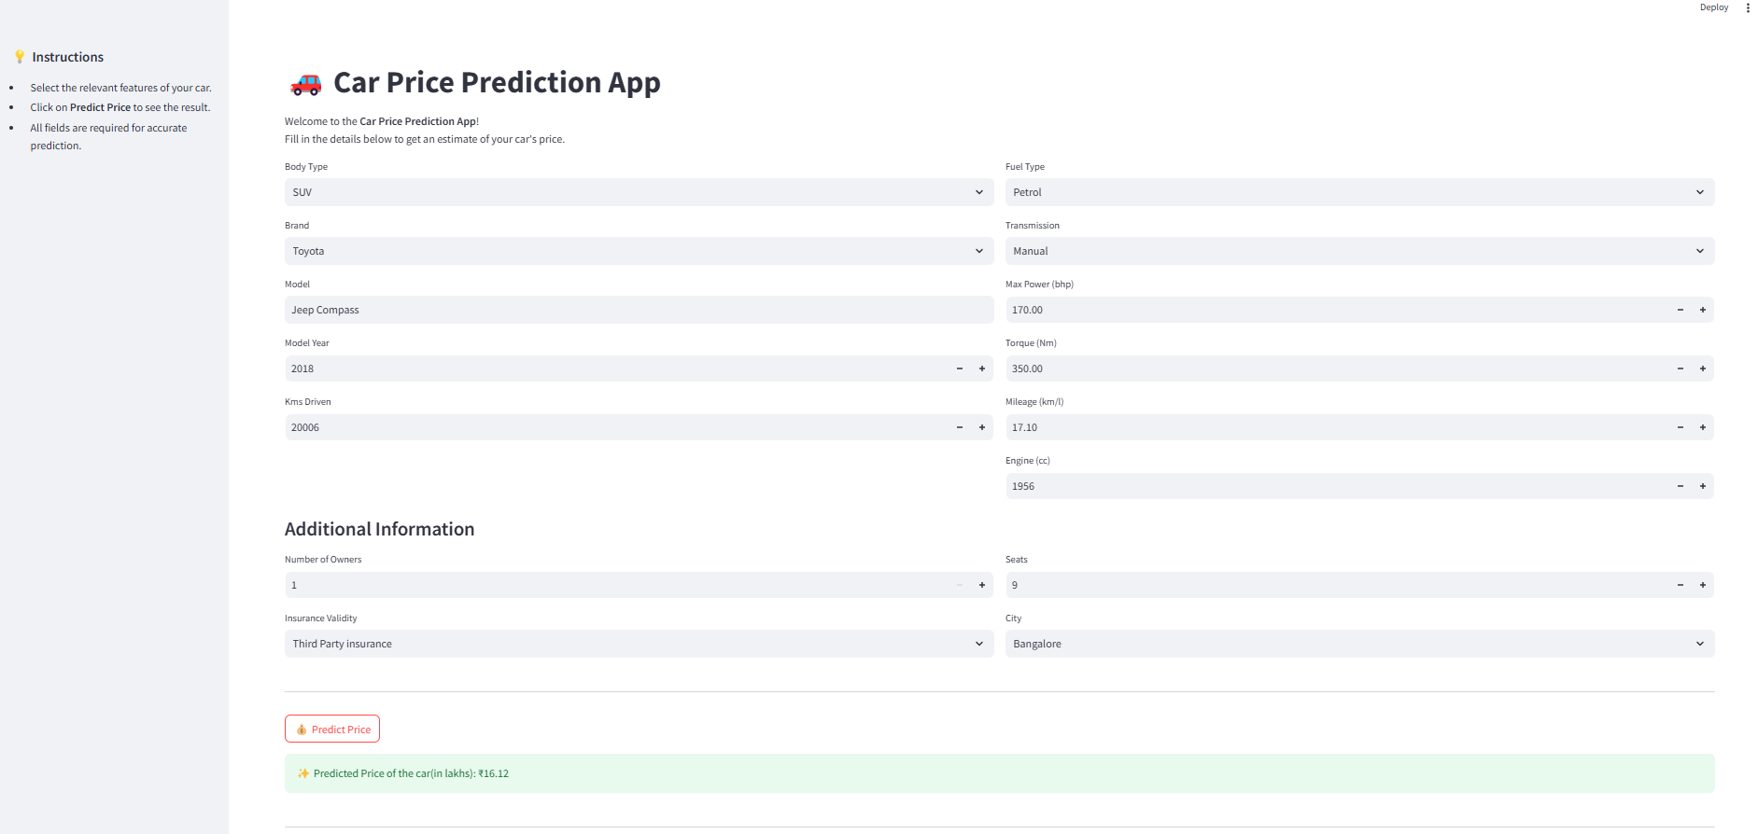
RESULT AND INSIGHTS.

Slide 12
CONCLUSION.
The project successfully developed a robust model for predicting used car prices, leveraging advanced machine learning techniques like XGBoost and regularization methods for accuracy and real-world applicability. Future enhancements include incorporating features like car condition and location for improved pricing precision and integrating deep learning models to enable image-based predictions, providing a more comprehensive and user-friendly platform for price evaluation.
The project demonstrated the effective use of machine learning models to predict used car prices, offering insights into key factors influencing vehicle valuation. The streamlined workflow, from data preprocessing to model optimization, ensured high performance and practical relevance. Looking ahead, expanding the application to include dynamic features like car condition and regional factors, along with leveraging deep learning for visual data, can further enhance its utility and broaden its scope in the automotive industry.

Slide 13
CONCLUSION.
THANK YOU

